Slide 1
Rainforests
Vulnerability of other systems
Regeneration rate
Total area and species diversity
Rainforest and “green politics”

Slide 2
Rainforests

Slide 3
Rainforest
28% of world’s oxygen turnover (CO₂ →O₂)
Huge amount of biodiversity
40-75% of all species
Large numbers of species endemic to area

Slide 4
Tropical Rainforests
Video 1
Video 2
Video 3
Video 4

Slide 5
Temperate Rainforests
Video

Slide 6
Rainforests

Slide 7
Rainforests
Most species have evolved to inhabit very specialized niches in their environment
When humans disrupt that environment, many species cannot survive
Humans have destroyed/disturbed about half of these forests
Because species depend on each other in a complicated web of relationships, changing just one part of the web harms the entire ecosystem
This breakdown of rainforest ecosystems will likely lead to the disappearance of up to 10% of the world’s species within the next 25 years

Slide 8
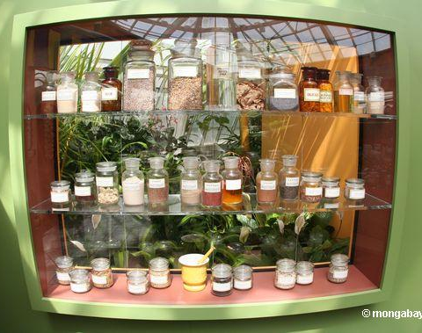
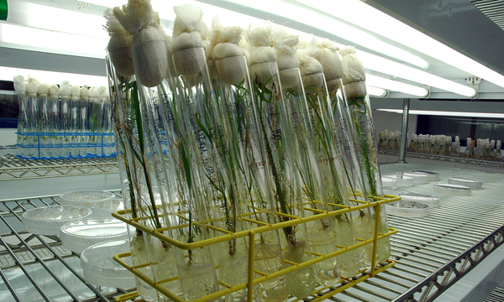
Rainforests
Humans depend on the rainforest’s millions of life forms for its own existence
The genetic diversity provides invaluable additions to the gene pool which help maintain and improve domestic crops
Without a diversity of strains, crops become overly homogenous and vulnerable

Slide 9
Rainforest Disruption
The projected major harmful effects:
Reduce Earth’s vital biodiversity
Destroying/degrading the habitats of unique organisms
Accelerate climate change due to global warming
Reduction of CO₂ consumption
Alter regional climate patterns to prevent return of diverse forests in cleared lands

Slide 10
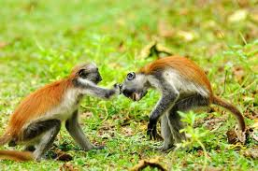
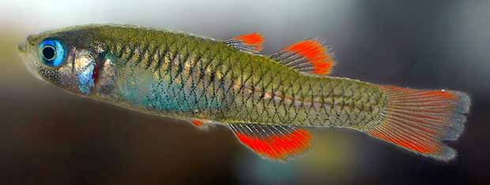
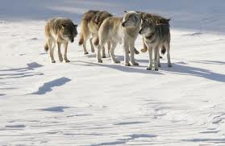
Arguments for preserving species and habitats
Ethical
Every species has a right to live
Wildlife has cultural importance
Depriving future generations

Slide 11
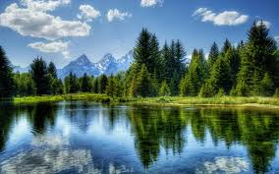
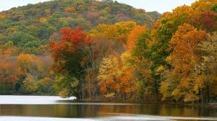
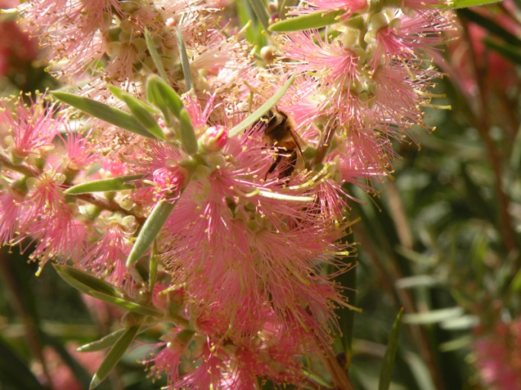
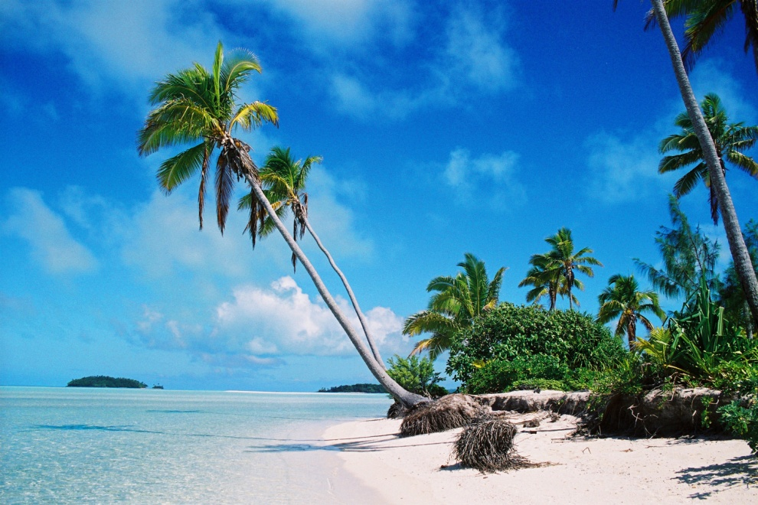
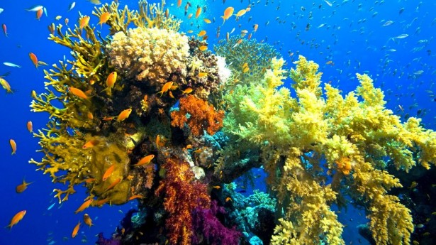
Arguments for preserving species and habitats
Aesthetic
The natural world is beautiful
It provides inspiration

Slide 12
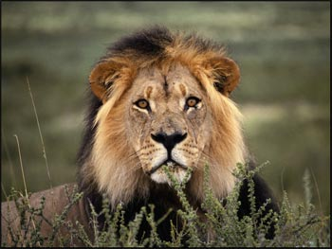
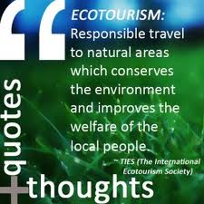
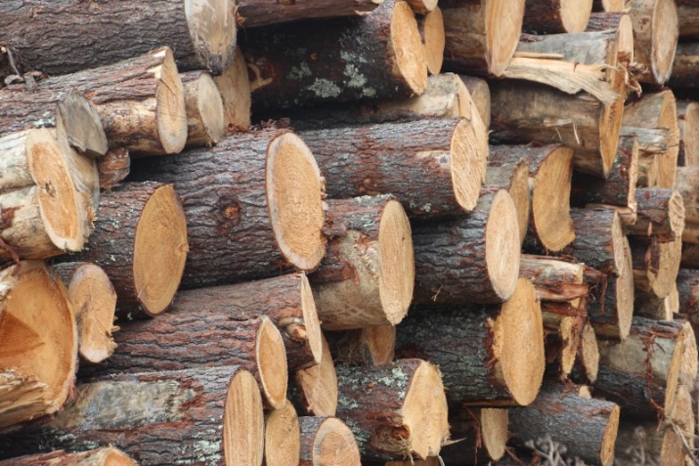
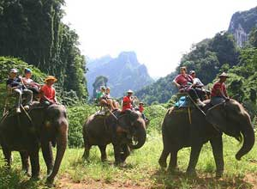
Arguments for preserving species and habitats
Economic
Economic Goods – food, fuel, lumber, etc.
New Commodities – medicines
New Crops – improves varieties (genes)
Eco-tourism – generates $500 billion worldwide
Male lion in Kenya generates $515,000 in tourist dollars but only $1,000 if killed for its skin

Slide 13
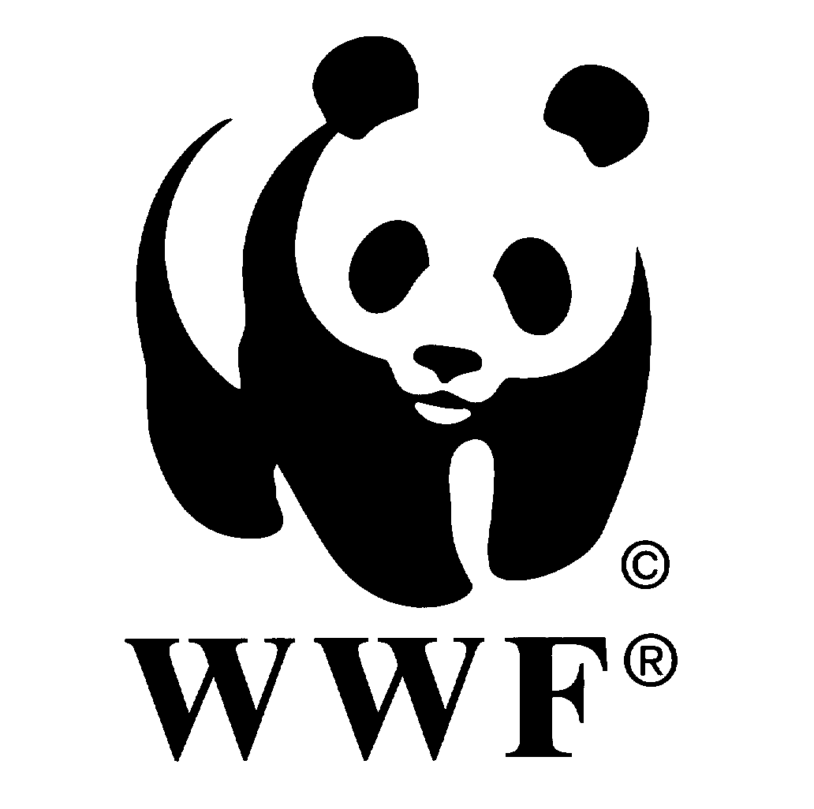
Governmental and Non Governmental Organizations
Governmental
UNEP
EPA
Non Governmental
Greenpeace
WWF

Slide 14
Governmental and Non Governmental Organizations
Governmental
intergovernmental
generally a part of multi-national organizations, especially the United Nations
most agreements are not legally binding under international law, but each signatory country is responsible for legislating and regulating conservation efforts within their own territory, the UN and other IGO’s
Examples: UNEP (United Nations Environment Programme), CITES, IPCC (Intergovernment Panel on Climate Change)
part or branch of a national, state, department, or local government
ultimately responsible to the voter
have the authority to prosecute violations of regulations within their jurisdiction
examples: Fish and Wildlife Service, Department of Agriculture, Eaux et Forets (Water and Forests), and other branches of local and national government agencies

Slide 15
Governmental and Non Governmental Organizations
Nongovernmental
work independently from governments to protect threatened species and areas
frequently form partnerships with GO’s and IGO’s to more effectively reach their targeted goals
Examples: WWF, Greenpeace, and too many others to list here.

Slide 16
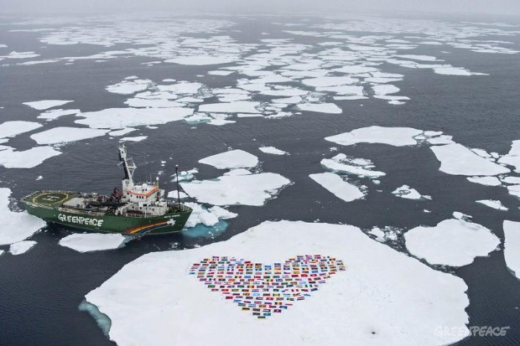
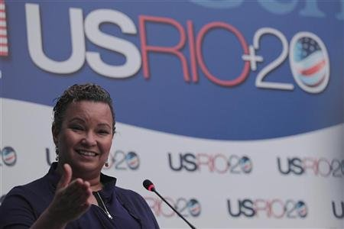
Governmental and Non Governmental Organizations
Go/IGO Use of media
NGO Use of Media
Media liaison officers prepare and read written statements
Use footage of activities to gain media attention

Slide 17
Governmental and Non Governmental Organizations
Go/IGO Speed of response
NGO Speed of response
Considered slow
depends on consensus often between differing views
Can be rapid

Slide 18
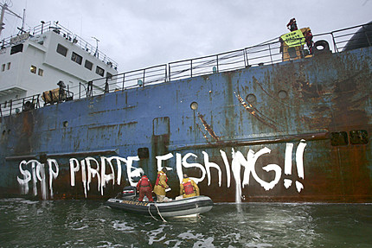
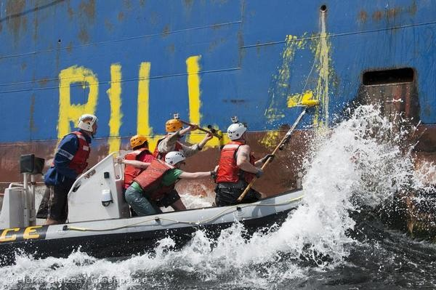
Governmental and Non Governmental Organizations
Go/IGO political diplomatic constraints
NGO political diplomatic constraints
Considerable
often hindered by political disagreement especially if international
Unaffected by political restraints
Can even include illegal activity

Slide 19
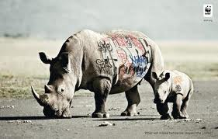
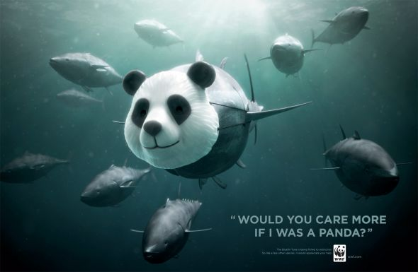
Governmental and Non Governmental Organizations
Go enforceability
NGO Enforceability
International agreements and national or regional laws can lead to prosecution
No legal power
Use of persuasion and public opinion to pressure governments

Slide 20
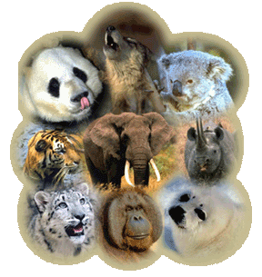
Strategies for Conservation Efforts
Species Approach —involves identifying which species are at greatest risk of becoming extinct, gaining a detailed understanding of the species, & focusing efforts to protect them
Strategies—
Identify endangered species
Protect their critical habitats
Tactics—
Legally protect endangered species
Manage habitat
Propagate endangered species in captivity
Reintroduce species into sustainable habitats

Slide 21
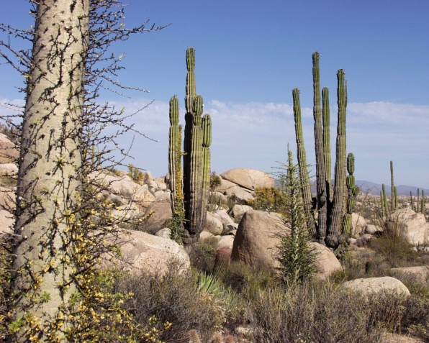
Strategies for Conservation Efforts
Ecosystem Approach —focuses on ensuring that enough land and aquatic areas are protected to provide habitat for the majority of terrestrial and aquatic wild species
Strategies—
Preserve sufficient areas of habitats in
different biomes & aquatic systems
Tactics—
Protect habitat areas through private purchase or government action
Eliminate or reduce populations of alien species from protected areas
Manage protected areas to sustain native species
Restore degraded ecosystems

Slide 22
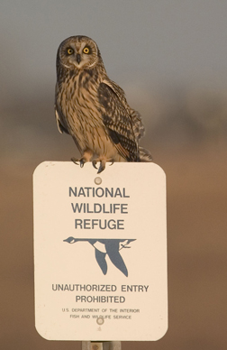
Solutions to Protecting Species
Wildlife Refuges
U.S. has 508
75% are to protect waterfowl

Slide 23
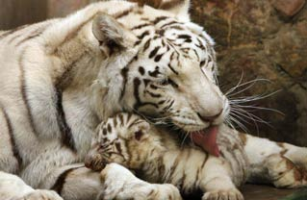
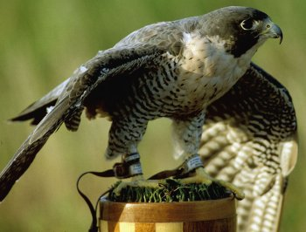
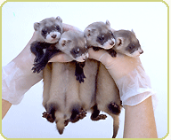
Solutions to Protecting Species
Zoos and Game Parks
Egg pulling —collecting wild eggs and hatching them
Captive breeding —wild individuals captured and bred in captivity – offspring reintroduced into wild
Peregrine falcon & black-footed ferret

Slide 24
Solutions to Protecting Species
Wildlife Management
Manipulating wildlife populations and their habitats for their welfare & for human benefit
Uses laws to regulate hunting & fishing
Establishes harvest quotas
Plants vegetation that are preferred food for wild species
Major flyways for migratory waterfowl are managed by international treaties

Slide 25
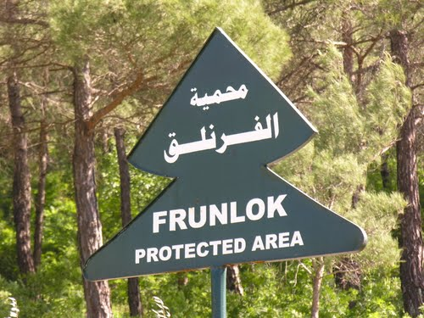
Criteria to design protected areas
Protected areas may become “islands” within a country and lose some of their diversity
Principles of island biogeography
Appropriate criteria
Size
Shape
Edge effects
Corridors

Slide 26
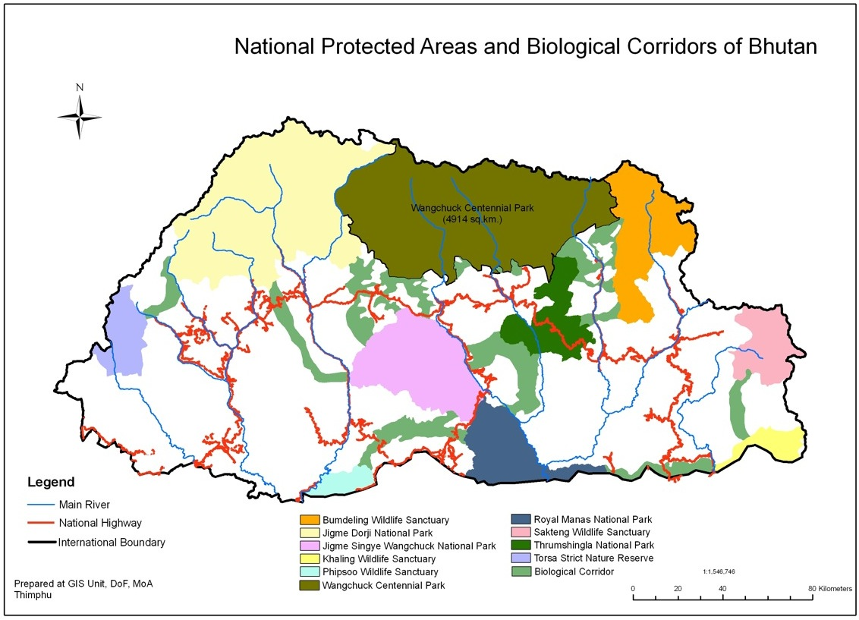
Why are the shapes of some protected areas better than others?
Size (should be large)
Supports more species and greater diversity
Less inbreeding
Less risk of natural disaster wiping out species

Slide 27
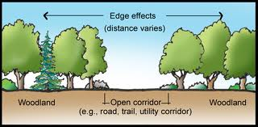
Why are the shapes of some protected areas better than others?
Edge effects (transition should be gradual, or edges should be minimal/natural)
Organisms at center are protected from influence of other organisms (farm animals, humans)
Edge organisms compete with outside organisms
Long/thin reserve has greater edge effect
Ecotone – where 2 habitats meet and there is a change near the boundary
Buffer zones can help
(semi-protected areas)

Slide 28
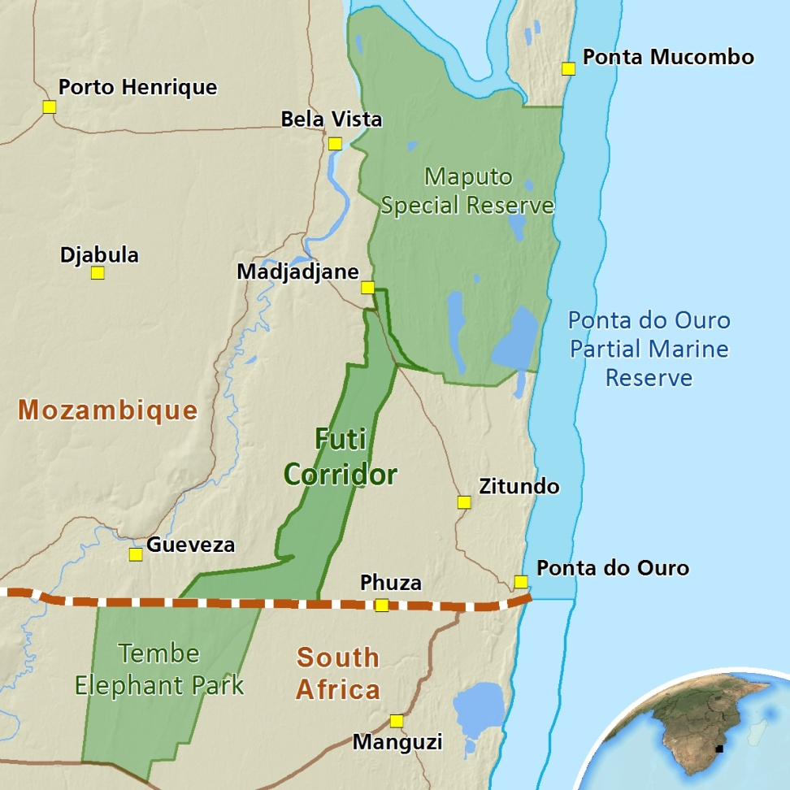
Why are the shapes of some protected areas better than others?
Corridors
Strip of land connecting two or more connected reserves
May be built under roads or railway lines
Not ideal but sometimes necessary
Can spread disease
More exposed to dangers (hunters/poachers)
Allow gene flow
Allow seasonal migrations

Slide 29
Why are the shapes of some protected areas better than others?
www.wcs.org/saving-wild-places/all-landscapes.aspx
Yellowstone
Patagonia and Southern Andean Steppe, Argentina

